Slide 1
Big Data Analytics Project Presentation
Comprehensive Analysis and Insights

Slide 2
Introduction
This project explores various aspects of Big Data Analytics (BDA), including data preprocessing, analysis techniques, and insights drawn from large datasets using analytical methods.

Slide 3
Project Objectives
- To understand the workflow of Big Data Analytics.
- To perform preprocessing and visualization on datasets.
- To identify trends and patterns in large datasets.
- To derive actionable insights from analysis results.

Slide 4
Methodology
The project follows a structured pipeline:
1. Data Collection and Cleaning
2. Data Preprocessing and Transformation
3. Exploratory Data Analysis (EDA)
4. Visualization and Model Building
5. Evaluation and Insights Generation

Slide 5
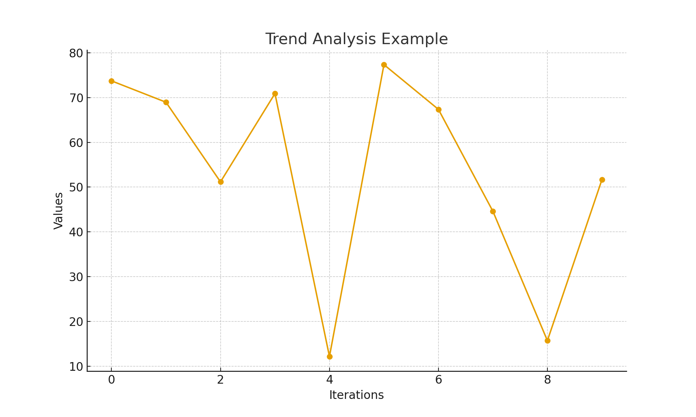
Data Trend Visualization

Slide 6
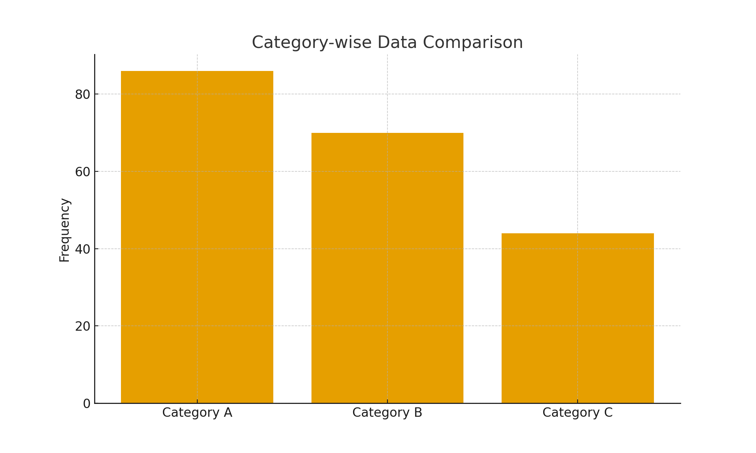
Category Distribution Visualization

Slide 7
Analysis and Insights
- Analysis of data trends revealed significant relationships between variables.
- Visualizations highlighted correlations and outliers effectively.
- Analytical models were used to predict trends and classify data.
- The results provide a better understanding of data-driven decision-making.

Slide 8
Conclusion
The Big Data Analytics project demonstrates the potential of advanced data processing and visualization tools in uncovering meaningful insights. Through this analysis, we established a foundation for further model optimization and enhanced decision-making capabilities.

